Slide 1
Social-Ecological Network Analysis
Jacopo A. Baggio, PhD
School of Politics, Security and International Affairs
Sustainable Coastal System Cluster, National Center for Integrated Coastal Research
University of Central Florida
Email: Jacopo.baggio@ucf.edu
Twitter: @Jacopo_80

Slide 2
Outline of the workshop
Introductions
Introduction to Networks: what are networks? From nodes to networks passing through motifs and graphlets
Social Ecological Networks (SEN)
Analyzing Networks two simple example (Alaska, and Pudget Sound)
SEN Motifs in brief
Break
Hands On example (will distribute data) and breakout groups
Report Back and conclusion

Slide 3
Introductions
Quick introduction: Name, Institution, Interest in Networks, Expectations for this 2 hr workshop

Slide 4
What are networks?

Slide 5
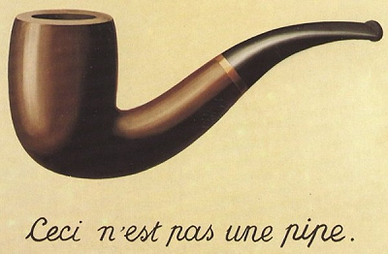
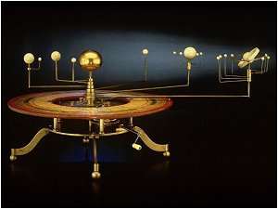
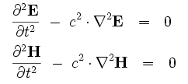
A Model…
This is not the Solar system
and this is not a light ray
A pattern, plan, representation, or description designed to show the structure or workings of an object, system, or concept
A minimum representation of a system that allows for investigation of the properties of the system and, in some cases, prediction of future outcomes

Slide 6
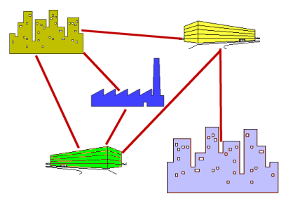
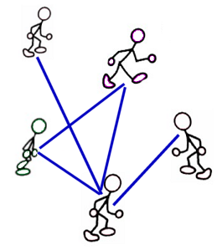
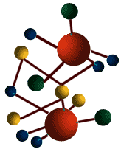
What is a Network?
A Network is a ”model”!
A collection of individual or atomic entities
nodes or vertices
Collection of links or edges between vertices
represent pairwise relationships
can have direction &/or weight
Network: entire collection of nodes and links visualized as a graph → mathematical methods
We are interested in properties of networks, often statistical properties of families of networks

Slide 7
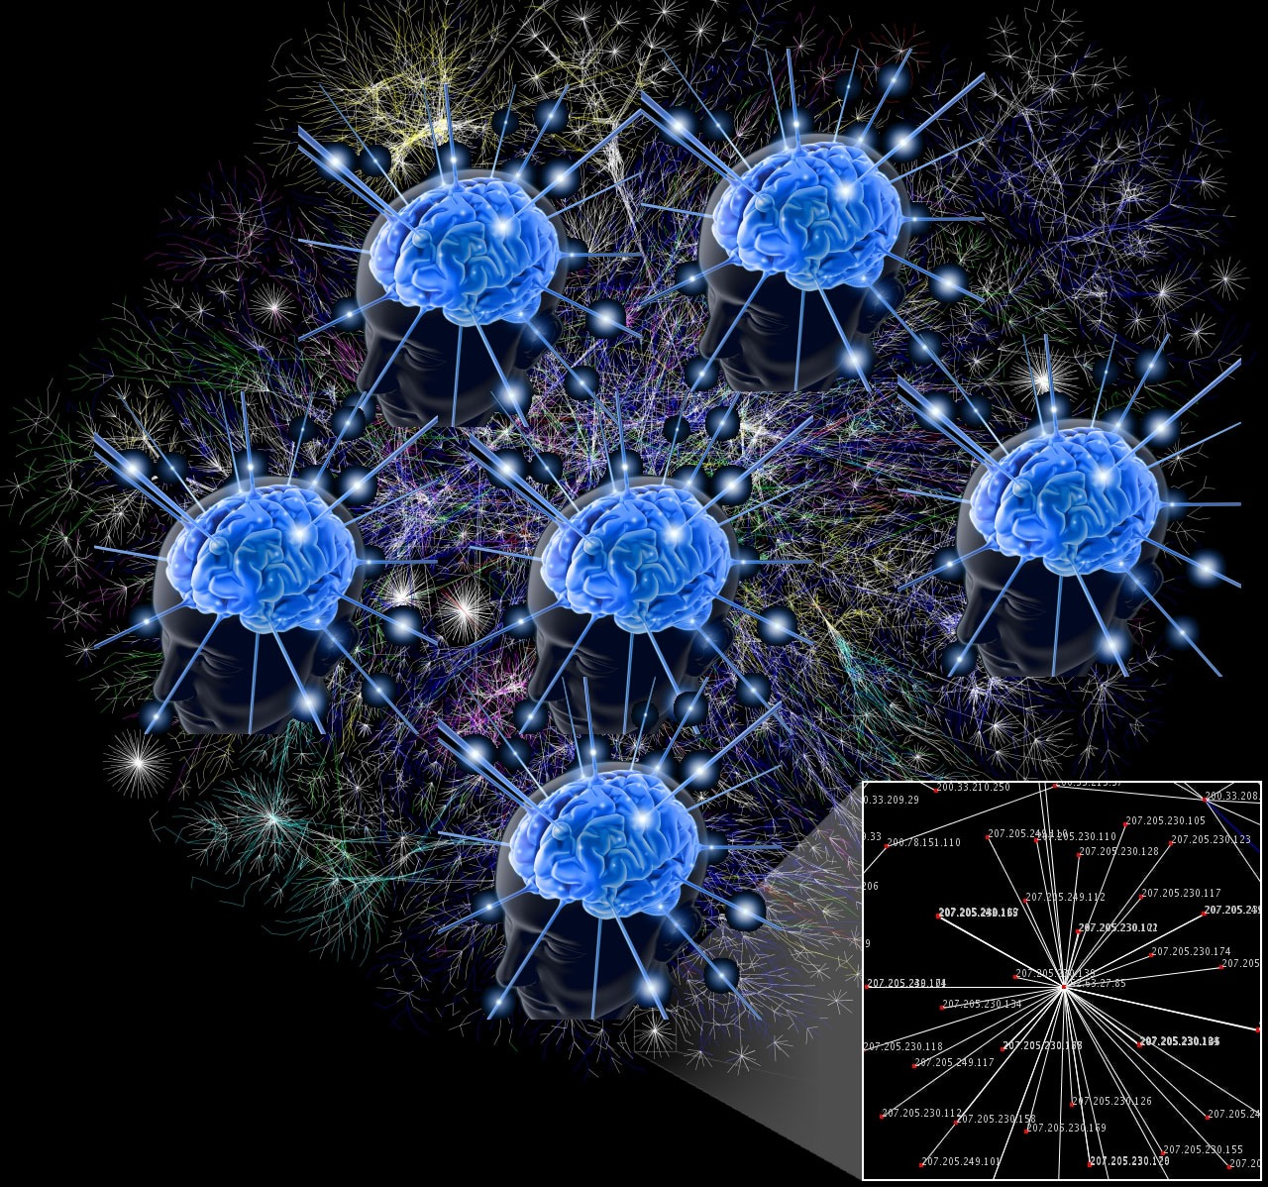
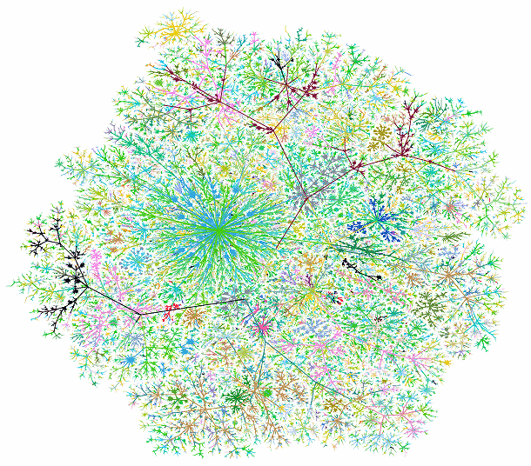
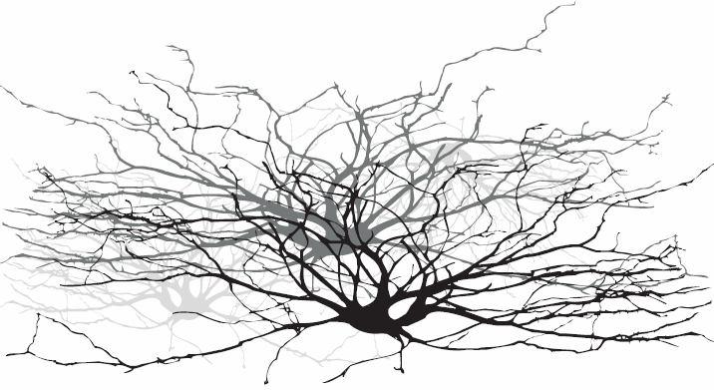
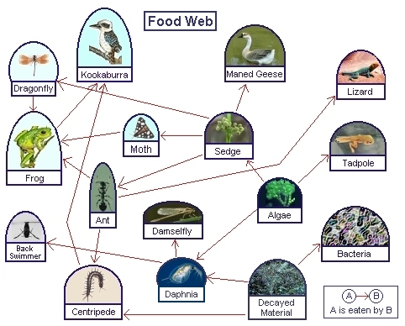
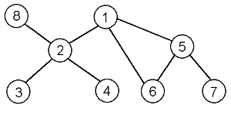
Networks are used…
Everywhere, from brains to societies, from rivers to food webs to protein interactions, from trade to governance and management.
node, vertex, actor
link, edge, tie, arcs

Slide 8
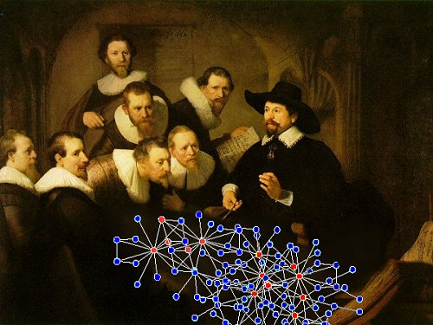
Why are networks important?
Network metrics define network topology
Topology of social networks affects the spread of information (and diseases), knowledge, strategy etc.
Topology of ecological networks can affect species migration patterns, species extinction probability, potential for invasive species etc.
NETWORK structure
affects
function(s)

Slide 9
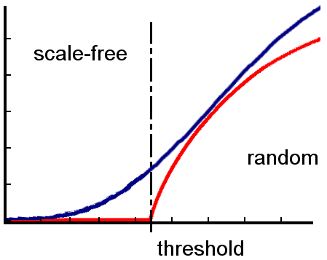
Networks: structures & processes
Epidemic spreading
Optimization
Baggio, J. A., & Hillis, V. (2018). Managing ecological disturbances: Learning and the structure of social-ecological networks. Environmental Modelling & Software, 109(August), 32–40. https://doi.org/10.1016/j.envsoft.2018.08.002
Baggio, J. A., Schoon, M. L., & Valury, S. (2019). Managing networked landscapes: conservation in a fragmented, regionally connected world. Regional Environmental Change, 19(8), 2551–2562. https://doi.org/10.1007/s10113-019-01567-8

Slide 10
From figures to Matrices…

Slide 11
Network: Mathematical Representation
V = {v₁…v_{n}}
Network: G(V,E)
E = {e₁…e_{n}}
Networks can be:
Undirected-unweighted (upper-left)
Directed-unweighted (upper-right)
Undirected-weighted (lower-left)
Directed-weighted (lower-right)

Slide 12
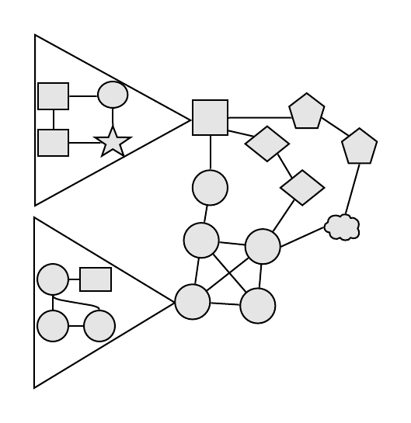
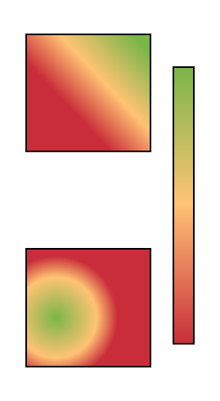
Nodes
Configurations
Motifs/Graphlets
Networks
Robustness/
Resilience
Disturbance Regime 1
Viable
A
B
C
D
Configurations
Disturbance Regime 2
Network
Not
Viable
A
B
C
D

Slide 13
Nodal metrics
Degree Centrality:
Measures how many connections a node has
Degree centrality can be used to assess how central patches on a landscape or popular individuals or individuals that are more able to diffuse information quickly.
Betweenness Centrality:
Measures how many shortest paths pass by a specific node
High betweenness centrality can indicate nodes that are more likely to “control” the flow of information (from landscape patches that are central in favoring migration of species to individuals that can act as gatekeepers or brokers
Eigen vector Centrality
Similar to degree centrality, BUT it takes also into account how connected neighboring nodes are (so not only how many connection I have, but how many connection the ones connected to me have)
High eigen-centrality can identify nodes that are important in affecting the overall network
Clustering Coefficient
How many of my friends are friends with each other? Or.. How many neighbors of node I are also connected to each others?

Slide 14
Network Metrics
Average metrics (average degree, average betwenness, average shortest path length, average clustering coefficient, global efficiency etc.)
Distributions: (i.e. Degree distribution, Betweeness centrality distribution, Clustering distribution etc..)

Slide 15
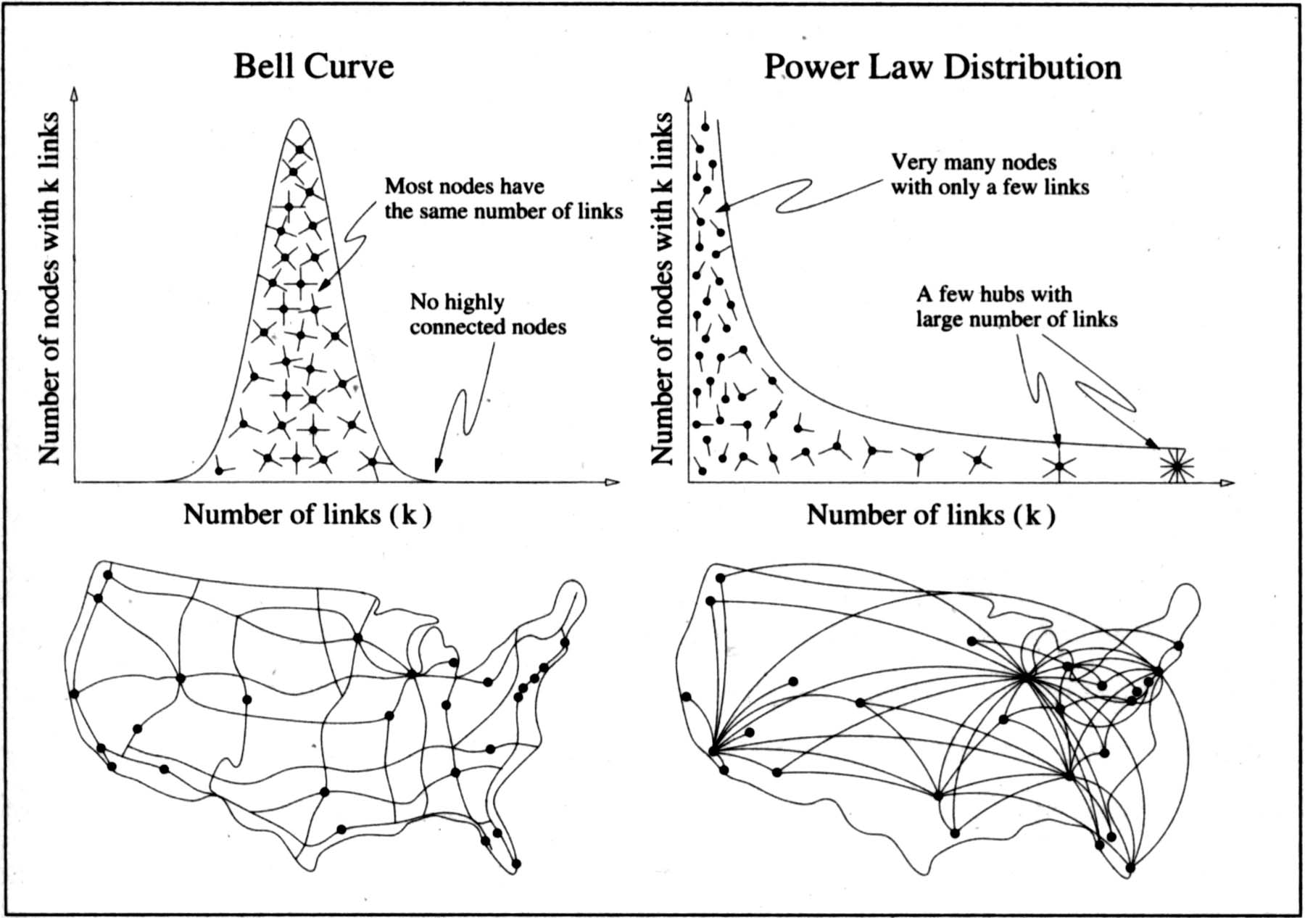
Degree distribution, simple implications

Slide 16
Modularity, Communities and participation coefficient
Communties are not easily found, but generally they refer to parts of the network that are densely connected while loosely connected to other parts of the network
Modularity is a measure that assesses how “divided” a network is into different communities.
Participation coefficient indicates how the degree of a node is “distributed” across communities (P = 0 if all edges are connecting nodes within the same community, 1 when edges are equally distributed across all communities.
Modularity network generator adapted from:
Sah, Pratha*, Lisa O. Singh, Aaron Clauset, and Shweta Bansal. "Exploring community structure in biological networks with random graphs." BMC Bioinformatics 2014, 15:220. doi:10.1186/1471-2105-15-220

Slide 17
Configurations: Graphlets and motifs
A graphlet is a subgraph of N nodes. As such, graphlets contain all edges of a specific subgraph.
Motifs are specific patterns within a network, a motif can contain only some edges of a graphlet of the same size.
Motifs need to be assessed vs a baseline model (that can retain basic properties, such as number of nodes, edges, degree distribution, clustering, etc.).
Assessment of motifs leads to calculate significance and over/under-representation vs baseline.
Pržulj, N. (2007). Biological network comparison using graphlet degree distribution. Bioinformatics, 23(2), 177–183. https://doi.org/10.1093/bioinformatics/btl301
Milo, R., Shen-Orr, S., Itzkovitz, S., Kashtan, N., Chklovskii, D., & Alon, U. (2002). Network motifs: Simple building blocks of complex networks. Science, 298(5594), 824–827. https://doi.org/10.1126/science.298.5594.824

Slide 18
Social-ecological networks

Slide 19
Social-ecological network “types”
Sayles, J., Mancilla Garcia, M., Hamilton, M., Alexander, S., Baggio, J., Fischer, A. P., … Pittman, J. (2019). Social-ecological network analysis for sustainability sciences: a systematic review and innovative research agenda for the future. Environmental Research Letters, 1–5. https://doi.org/10.1088/1748-9326/ab2619

Slide 20
imagine
You want to assess how food sharing may be affected by changes in the social as well as in the biophysical domain
You need to take into account:
biophysical elements (i.e. species hunted or harvested)
social (i.e. cooperation, helping or simply sharing with those in need, contributions etc…)
Single (“monoplex”) networks fall short as they would not be able to characterize the system properly …(i.e. not an adequate model representation)

Slide 21
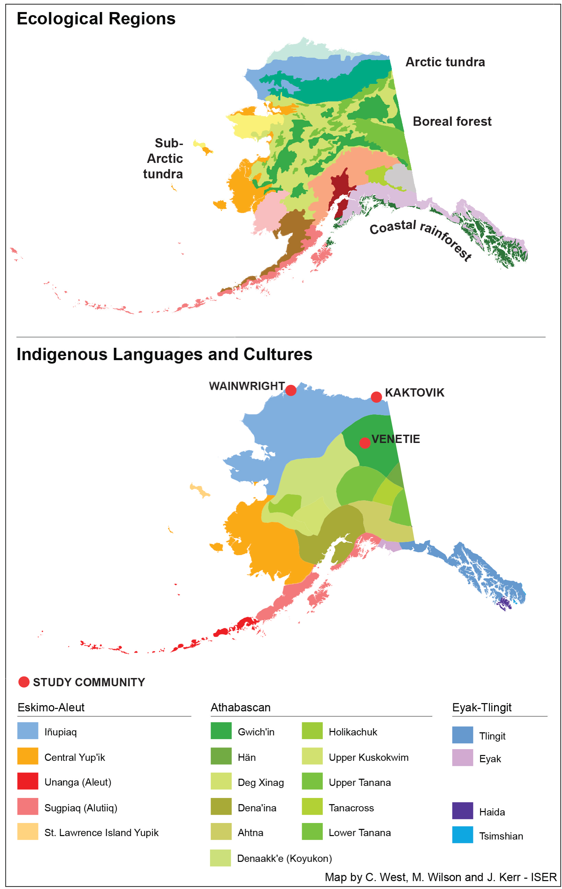
Community Robustness and Social-Ecological Networks
Baggio, J. A., Burnsilver, S. B., Arenas, A., Magdanz, J. S., Kofinas, G. P., & De Domenico, M. (2016). Multiplex social ecological network analysis reveals how social changes affect community robustness more than resource depletion. PNAS, 113(48), 13708–13713. https://doi.org/10.1073/pnas.1604401113
Mixed subsistence-cash economies
Plausible future social changes relate to migration, job creation/dissolution, market integration
Plausible future ecological changes relate to ice cover, air and water temperature that influence species abundance
Cultural norms related to sharing are key for food security, group identity, well being.
Analysis of subsistence food flows between HH depending on resource type and specific social relation
Notes:
Study Area: in Alaska, there is strong overlap between ecosystems and ethnolinguistic territories of indigenous groups. I~nupiaq territory is coastal, allowing access
to diverse terrestrial, riverine and marine resources, while Gwich'in territory allows direct access only to terrestrial and riverine resources;
Example: We go hunting beluga together, I give you ammunitions to hunt caribou, you give me caribou meat because I give you a snow-machine, we go hunting caribou together, you just share some caribou meat with me etc…

Slide 22
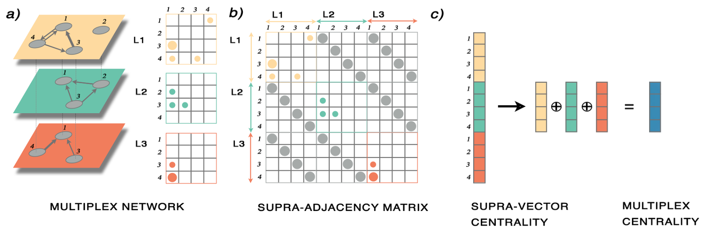
Multiplex Networks
Notes:
Schematic illustration of multiplex representation and analysis. (A) Toy network with N = 4 nodes and L = 3 layers (note that not all nodes exist on all layers), building an interconnected multiplex system. Each layer is encoded by a different color. The network is directed (encoded by arrows) and weighted (encoded by edge thickness). The adjacency matrices, corresponding to each layer separately, are also shown. This system is mathematically represented by a rank-4 tensor Mi j , with i; j = 1; 2; :::;N indicating nodes and ; = 1; 2; :::;L indicating layers. (B) Matricization is applied to flatten the rank-4 tensor to a rank-2 supra-adjacency matrix, a matrix of matrices, without loss of topological information. In the supra-adjacency matrix, the adjacency matrices representing layers are placed as blocks on the main diagonal, whereas inter-layer connectivity is encoded into diagonal matrices that are placed on the o-diagonal blocks. (C) The multiplex centrality of each node in each layer is calculated from the supra-adjacency matrix, to obtain a supra-vector as a result (note that this is very different from calculating the centrality vector from each layer separately). The components of the supra-vector are N X L: they are separated into L vectors and summed up entry-wise, as shown, to obtain the final multiplex centrality of each node. It is worth remarking that this approach takes into account, simultaneously, both intra- and inter-layer connectivity, and it has been shown to be a natural generalization of eigenvector centrality (as well as other centralities based on the calculation of the leading eigenvector of a certain matrix) to the multiplex domain

Slide 23
Robustness Analysis
Notes:
Robustness of multiplex networks to perturbations. Shown are changes represented by targeted vs. random removal nodes (households) and layers (social relations, species, and species groups). Robustness patterns strongly depend on the perturbation type. Interconnectedness in the case of random removal scenarios is averaged over 100 realizations of random removal of nodes [household (HH) loss] or layers (social relation loss and resource loss)
In Wainwright, targeted removals of 20% of households resulted in a 66% reduction in interconnectedness, whereas targeted removals of 20% of social relations (e.g., sharing, cooperative hunting, and contributions) resulted in an 80% reduction in interconnectedness. A loss of key households in Wainwright has less of an effect than in Kaktovik and Venetie.Targeted removals of two core ecological resources (29% of core resource layers) resulted in a 65% reduction in interconnectedness. In Kaktovik, targeted removals of 20% of households resulted in an 80% reduction in interconnectedness, and targeted removals of 20% of social relations also resulted in an 80% reduction in interconnectedness. Targeted removals of two core ecological resources (29% of core resource layers) resulted in a 62% reduction in interconnectedness. And in Venetie, targeted removals of 20% of households resulted in an 80% reduction in interconnectedness, whereas targeted removals of 20% of social relations resulted in an 80% reduction in interconnectedness. Targeted removals of two core ecological resources (20% of core resource layers) resulted in a 54% reduction in interconnectedness.

Slide 24
imagine
You want to assess water governance in an estuary region
You need to take into account:
biophysical elements (water flows, biota)
social (water management associations, local and regional governing bodies, private actors, NGO, etc.)
Single (“monoplex”) networks fall short as they would not be able to characterize the system properly …(i.e. not an adequate model representation)

Slide 25
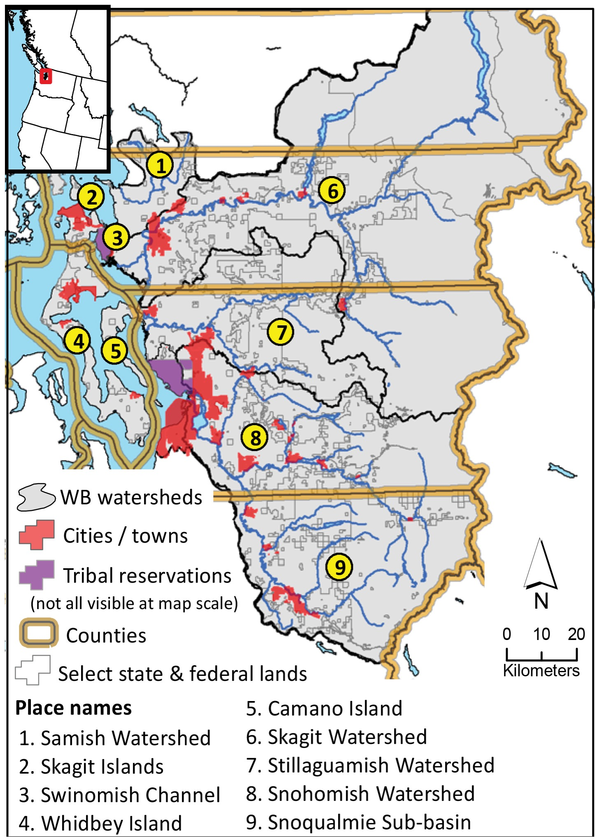
Restoration and Social-Ecological Networks
Fragmented Governance in Bio-physically connected regions
Considering governance capacity with ecological conditions may help policy makers allocate resources
Assess scale mismatches and effects on ecological habitat
Use of Network Science as a diagnostic tool
Sayles, J. S., & Baggio, J. A. (2017). Who collaborates and why: Assessment and diagnostic of governance network integration for salmon restoration in Puget Sound, USA. Journal of Environmental Management, 186, 64–78. https://doi.org/10.1016/j.jenvman.2016.09.085
Sayles, J. S., & Baggio, J. A. (2017). Social–ecological network analysis of scale mismatches in estuary watershed restoration. PNAS, 114(10), E1776–E1785. https://doi.org/10.1073/pnas.1604405114
Notes:
Study area with place names used in the text. Major watersheds and several jurisdictional units are shown to illustrate scale mismatch. Only two of six tribal reservations are visible at this map scale. Depicted state and federal land holdings are not exhaustive, but included for reference. Other jurisdictions and organizations are excluded for clarity
Scale mismatches can also arise if organizations cannot work together due to (for example): Lack of trust, authority inequality, insufficient resources, legitimacy and fairness issues Self-assessed productivity of collaborations!
How do collaborations/coordination patterns map onto the landscape?
How do collaboration/coordination patterns relate to ecological processess?

Slide 26
﻿
Who works with whom?
Organization Type | Abbreviation
City & town Citizen group | CTT
Coordinating & watershed groups | CZG
County | COU
Federal | FED
Nonprofit | NPR
Other | OTH
Public utility | PUT
Business | BUI
Special districts | SPD
State | STA
Tribe | TRB
Education | EDU
Sayles, J. S., & Baggio, J. A. (2017). Who collaborates and why: Assessment and diagnostic of governance network integration for salmon restoration in Puget Sound, USA. Journal of Environmental Management, 186, 64–78. https://doi.org/10.1016/j.jenvman.2016.09.085

Slide 27
Breaking down: who works with whom
Colors indicate PM score. Data should be read across rows; for example, top row represents PM scores from cities/towns (CTT) to other organization types.
Median, 25th, and 75th percentile module-to-module participation (PM) scores among different group types in the salmon restoration network
Module to module participation score (PM) based on whether collaboration were mandated, funded or born out of shared interest

Slide 28
Building Social-Ecological Networks
Two types of Social Nodes
Local and Regional
Where do organizations work?
GIS Integration of organizations and ecological patches
Mapp social edge metrics on ecological network
Thickness indicates value of a specific network metric used
Sayles, J. S., & Baggio, J. A. (2017). Social–ecological network analysis of scale mismatches in estuary watershed restoration. PNAS, 114(10), E1776–E1785. https://doi.org/10.1073/pnas.1604405114

Slide 29
Structures of collaboration in biophysical context
Density
Is scale mismatch being overcome?
Controlling for the confounding effect of network size
Centralization
Asymmetry of power or efficiency?
Productivity
Notes:
Measures of network structure and quality among social nodes (n=210) working in hydrologically connected ecological nodes (n = 38).
Collaborations among and between different governance levels are depicted in map tiles from left to right. Line thickness and color are used to summarize social network patterns, which are mapped onto the ecological network.
if observed density is greater or less than expected (based on a 1,000 random simulations, see methods) illustrates, from a structural perspective, if scale mismatches are being overcome. This controls for the confounding effect of network size on density, which prohibits directly comparing different areas.
If observed density is less than expected more edges should be present by chance and scale mismatch is not being overcome.
If greater than expected, scale mismatch is being overcome.
Probability values (p) are grouped at 0.05, 0.25, and 0.50 thresholds (i.e., there is less than a 5%, 25%, or 50% chance that the observation occurs randomly).
Centralized networks are vulnerable to targeted node removal and are sometimes associated with power asymmetries, but can increase efficiency under certain conditions. CD is mathematically undefined at the aggregate level (see methods).
Productivity depicts the ratio of productive and unproductive edges (-1 = 100% unproductive and 1 = 100% productive), as assessed by study participants, and identifies where collaboration and coordination problems may lie.
Centralization question: For degree centralization (CD), Freeman’s [84] formula was used for regional-to-regional edges and Everett’s and Borgatti’s [85], modified
bipartite CD was used for local-to-local and local-to-regional. Following Everett and Borgatti [85], isolates (nodes with no SS edges) were ignored for all CD measures, and nodal centrality
was normalized by the number of nodes in the opposite node set for bipartite measures. Centralization for the summation of all edges was not calculated because this
is essentially a hybrid between a normal and bipartite network structure and no formal equation exists to define centralization in this hybrid case
edges

Slide 30
Integrating Networks and Ecological Indicators
Notes:
Habitat integrity index plotted against productivity.
A) Average productivity edge values were calculated for each ecological node (HUC 10s). Local-to-regional is shown as an example. HUC 10s and smaller habitat integrity units were spatially joined to combine social and ecological attributes.
B) Habitat integrity is plotted against productivity to simultaneously consider ecological and social opportunities and challenges for restoration

Slide 31
Network motifs: Analyzing social ecological networks
Bodin, Ö., Robins, G., McAllister, R. R. J., Guerrero, A. M., Crona, B., Tengö, M., & Lubell, M. (2016). Theorizing benefits and constraints in collaborative environmental governance: A transdisciplinary social-ecological network approach for empirical investigations. Ecology and Society, 21(1), 40. https://doi.org/10.5751/ES-08368-210140
Bodin, Ö., & Tengö, M. (2012). Disentangling intangible social-ecological systems. Global Environmental Change, 22(2), 430–439. https://doi.org/10.1016/j.gloenvcha.2012.01.005

Slide 32
Software: no analysis without good software
Matlab, Python and R: allow to write your own scripts and routines, but steeper curve to learn.
Gephi, Pajek, Cytoscape, UCINET: easier interface, plugins allow flexibility, but harder to write your own scripts/routines.
Basic Network Packages for Python and R
Python: and networkx and igraph, pymnet
R: sna, igraph, statnet, MuxViz
No “ideal” solution
Typically need to use a combination of softwares
Often different algorithms (or implementations) → different outcomes
Often need to code own routines

Slide 33
Hands on!
Let’s put into practice what we have seen so far!

Slide 34
Some background
Water governance implies institutions and organizations involved in the development and management of water resources. Water resources are, often, considered common pool resources, especially when no single individual holds specific rights to water.
This implies that water, within individual accessing it, is a non-excludable (I can not exclude another to access it) but rivalrous (the more I access/pollute, the less you can use the water)

Slide 35
… once upon a time… in an undisclosed location…
There where 40 different organizations able to access and affect water flows among four different rivers within a watershed.
Some of these organizations were able to establish collaborations to co-manage access and water resources, however, not all organizations were able to collaborate with everyone else.
To assess collaboration and potential issues with respect to the water common pool resource system, researchers mapped the collaboration between the 40 organizations and also where these organizations were located and to which “part” of the river system they had access too (and thus could either withdraw resources or pollute or try to preserve it for other uses (i.e. fishing, tourism etc..).

Slide 36
A network study on collaboration and river system
Given the brief description of the scenario above:
What type of network would you build? – not articulated, semi articulated or fully articulated SEN?
How would you construct the social-ecological network? (define nodes and edges in both ,the social and the biophysical system and how they link to each other)
What metrics and what structural properties you think would be important to assess to elicit whether the overall common pool resource system may incur in governance issues?
Is it possible to define key actors (actors that are more likely to control the flow of information within the collaborative network or that are key to “bridge” the different organizations?)
What role could motifs play in such network?

Slide 37
Hands on! Let’s put into practice what we have seen so far!
Download the following files from github
SENAWk,
Snet (the social/organization collaboration network)
Bnet (the biophysical / river network)
Sbnet (dictionary indicating what river part is affected by which organization)
The SENAWk contains a Jupiter notebook (similar to the one you have seen so far) to play and use it you can:
IF you have python installed and jupiter notebooks, open it directly with jupiter notebooks
OR you can open it via google colaboratory, without the need to install Jupiter notebook or python (I hope…)

Slide 38


